Slide 1


24 July 2024
SECURING GHANA’S DIGITAL ECONOMY:STRATEGIES FOR BUILDING TRUST AND RESILIENCE
Ransford Nana Addo Jnr.
EMBA, PCI ®, CFE ®, CFC™ , CCO

Slide 2

Todays’ Agenda
Characteristics Of A Digital Economy
01
Ghana Digital Ecosystem Outlook
02
Threats to Ghana’s Digital Economy
03
Securing Ghana’s Digital Economy:
04
Building Trust & Resilience
05
Concluding Thoughts
06

Slide 3
Characteristics Of The Digital Economy
AUTOMATION & AI
DATA AS A CORE ASSET
Automation, machine learning, and artificial intelligence optimize operations, reduce costs, and enhance customer experience..
Data collection, analysis, and utilization drive decision-making, product development, and personalization of services.
DIGITAL PLATFORMS
INTANGIBLE GOODS AND SERVICES
Online platforms like e-commerce sites, social media, and mobile apps enable businesses to reach a global audience..
Unlike the traditional economy that is heavily reliant on physical goods, the digital economy includes services like streaming media, software, digital content, cloud computing, and more..
INTERNET - DRIVEN
ALMOST CASHLESS
The digital economy leverages the internet for communication, transactions, marketing, and the delivery of goods and services..
Digital Payments: Mobile payment systems (Apple Pay, Google Wallet) and cryptocurrency transactions (Bitcoin, Ethereum)

Slide 4
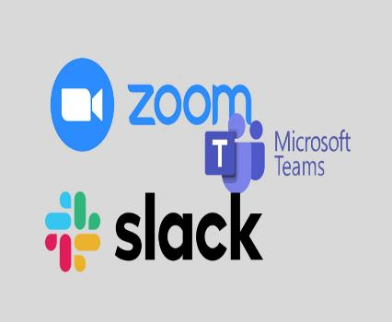
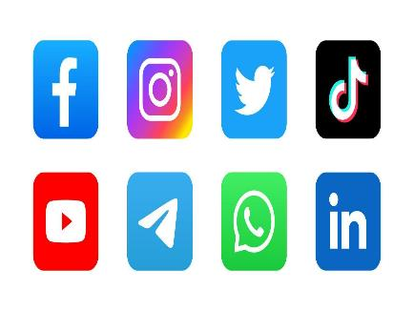






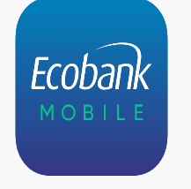
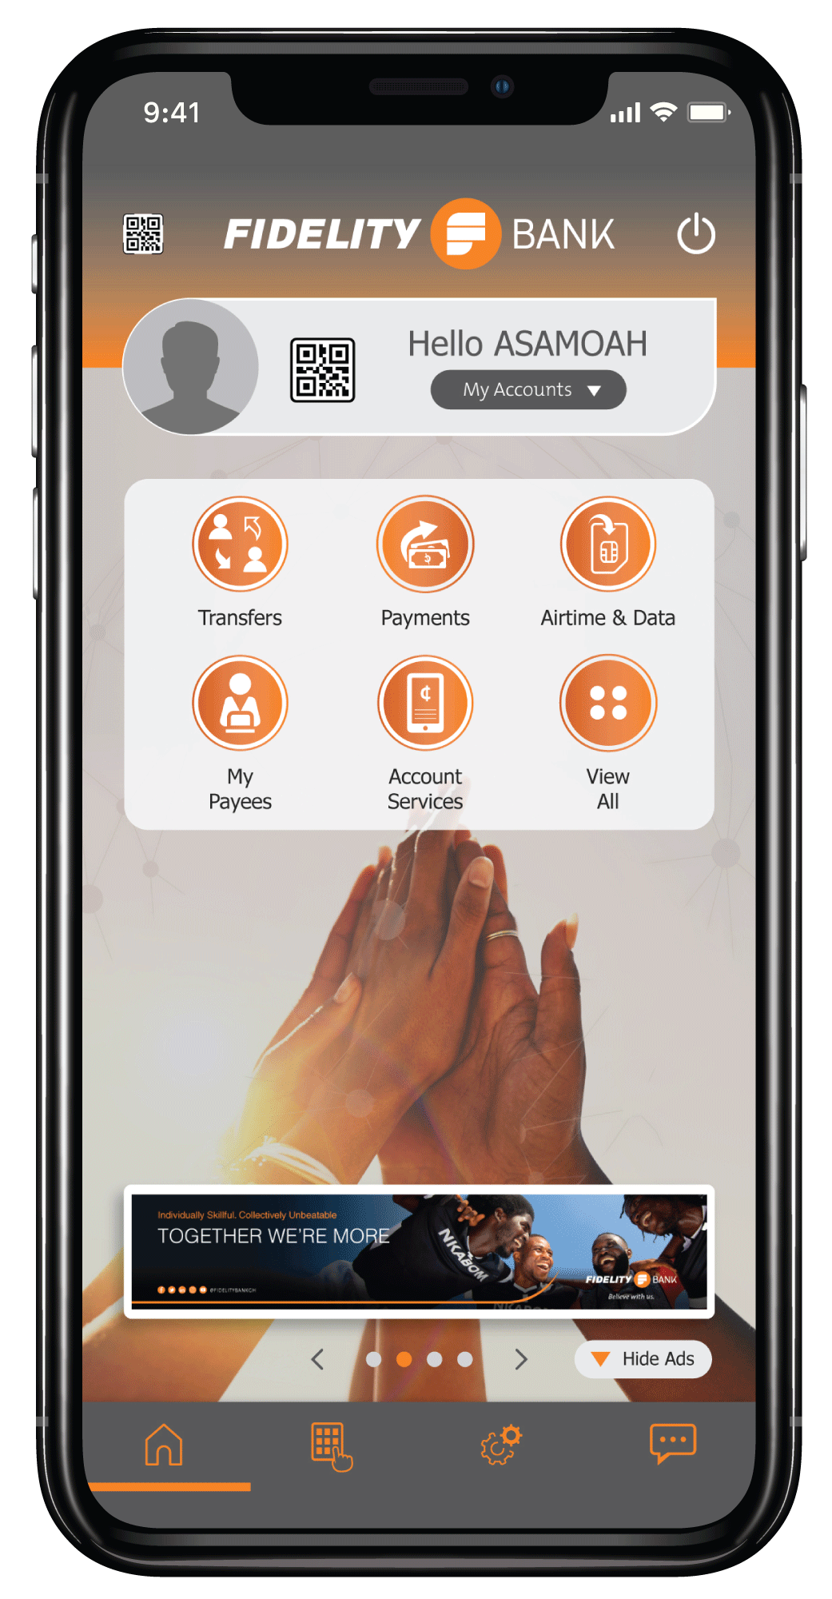







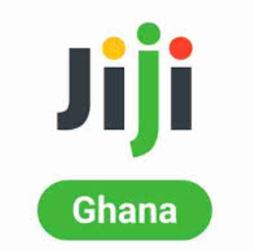





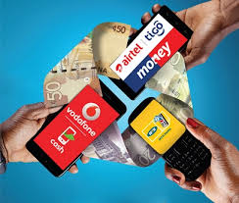
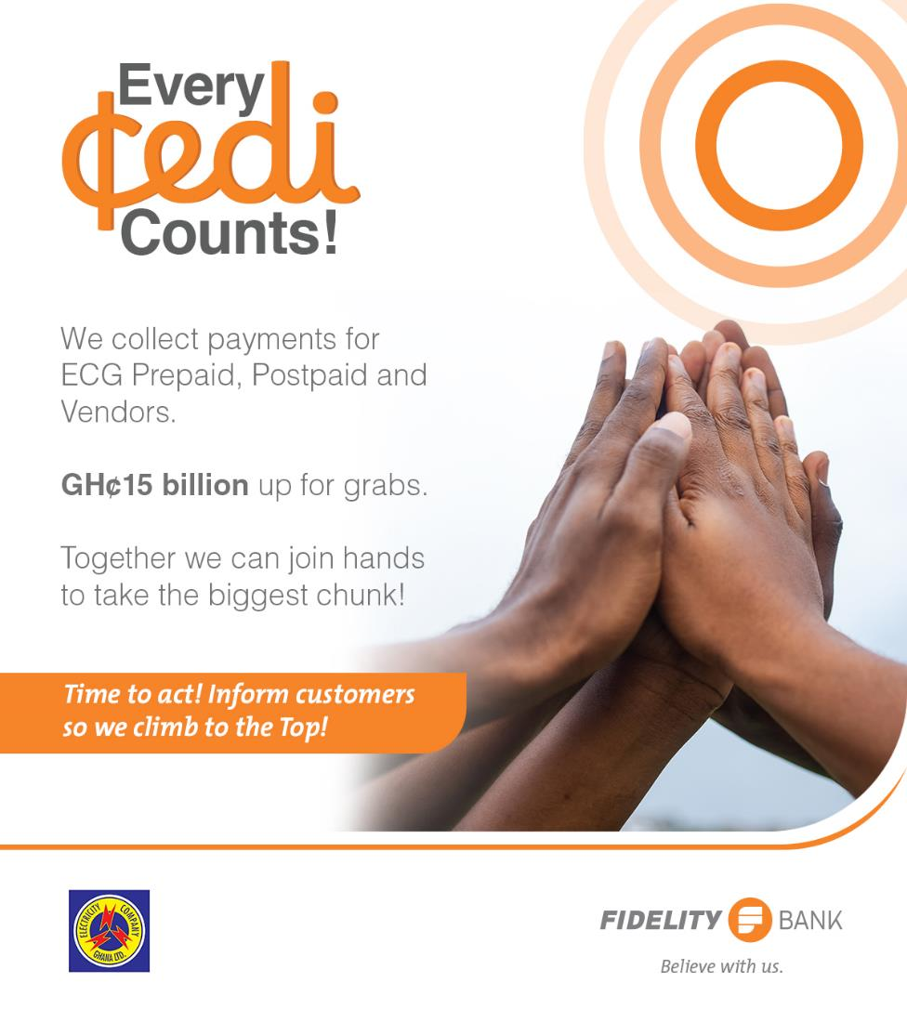

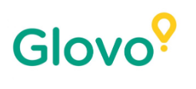
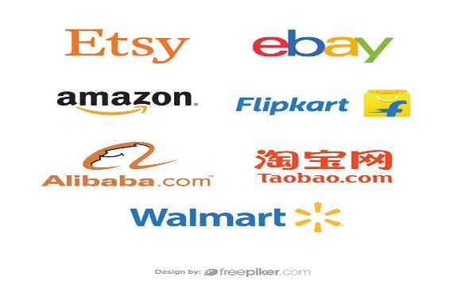




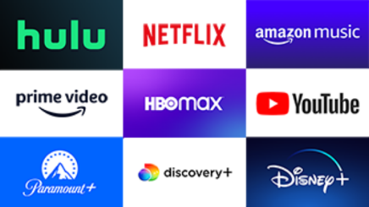






Slide 5
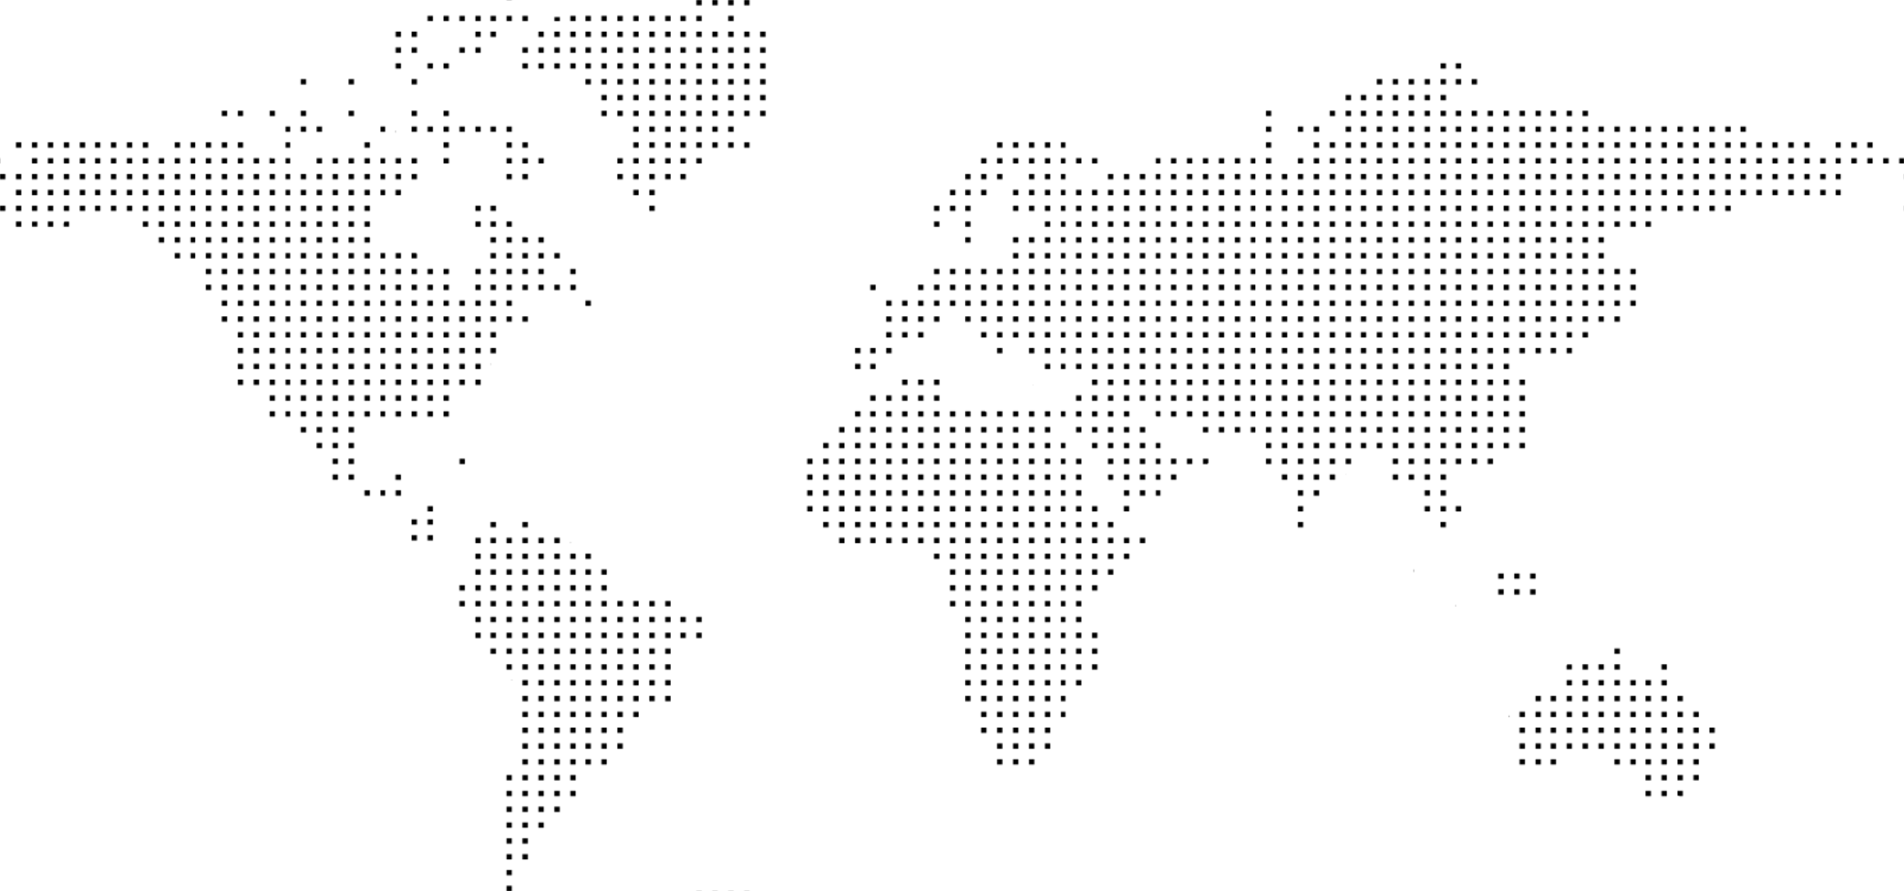
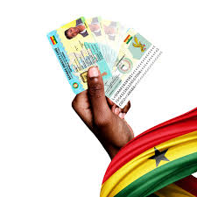




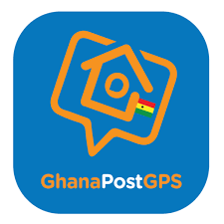



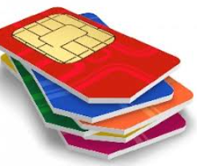


Ghana Digital Ecosystem Outlook
28%
High Mobile Penetration
Dominance of MoMo
  GHS 3Tn
87% of Ghana’s Population are Mobile Phone User
Over 3 Trillion Ghana Cedis in 2024 compared with 1.9 Trillion in 2023.
Growth in Digital Economy
63%
  Vibrant Fintech
  Ecosystem
Africa Funding dropped 45%
  70+
Mobile Money Explosion
Active fintech companies with over 300 tracked across the sector.
Ghana continues to receive investment in the area of Fintech Innovations
74M
Registered Momo Accounts

Slide 6

"When digital transformation is done right, it’s like a caterpillar turning into a butterfly, but when done wrong, all you have is a really fast caterpillar."
George Westermann

Slide 7


Threats to Ghana’s Digital Economy
Money Laundering & Other Crimes
Business Email Compromise
Social Engineering
SIM Swap
Hacking
tricking employees into transferring money or sensitive information to fraudulent accounts.
Online Scams
Digital Threats
DoSS & Phishing Attacks
Shopping
Romance
Recruitment
Advance Fees.
trick victims into revealing sensitive information via fake emails, texts, or websites.
Data & Identity Theft
Deep Fake
Criminals steal personal information, like names, addresses, and social security numbers, to gain access to your accounts, credit cards, or loans.
Uses artificial intelligence and machine learning to create convincing fake audio, video, or images.

Slide 8



Evolution of Financial Crimes in Ghana
2010
Automated
2000
Use of technology, algorithms, and automation tools to perpetrate fraudulent activities. E.g Automated Account takeover
Organised
1990
Involves deliberate, structured and Coordinated efforts by groups or networks. Often involving international network. E.g Money Laundering
Planned
1980
Opportunistic
Pre-meditated, Deliberate and Carefully planned and executed. This involves complex schemes, concealment and deception.
Losses
Spontanous fraudulent activities committed, ofe to unforeseen circumstances or unexpected opportunities rather than being planned. E.g Exploiting weaknesses or loopholes
Time / Confidence / Sophistication

Slide 9
Ghana – Digital Entertainment Vrs. Innovation
Crime & Security
Agriculture & Food Security
Cybersecurity
Tunisia
Morocco
Algeria
Libya
weather forecasts, market prices, and extension services.•
Blockchain for Traceability: Used for export compliance and food safety.
Crop monitoring and disaster forecasting.
Digitized Policing: Use of databases, surveillance systems (e.g., CCTV in Accra), and crime reporting platforms.
•Cybersecurity Strategy: Laws and tools to combat online fraud, identity theft, and financial scams.
Western Sahara
Egypt
Senegal
Mauritania
Mali
Niger
Eritrea
Gambia
Chad
Sudan
Djibouti
Guinea-Bissau
Guinea
Nigeria
Ethiopia
Sierra Leone
South Sudan
Liberia
Cameroon
Central African Rep.
Somalia
Côte d'Ivoire
Benin
Uganda
Healthcare Delivery
Environmental Protection
Togo
Congo
Kenya
Burkina Faso
The Democratic Republic of the Congo
Rwanda
Ghana
Burundi
e-Health Records: Digitized patient records improve continuity of care and reduce duplication.
Telemedicine: Remote consultations help bridge the doctor-to-patient ratio, especially in rural areas.
Drone & Satellite Monitoring: Used to detect illegal mining (galamsey) and monitor forest cover.
Digital Licensing & Reporting: Tools for enforcing environmental compliance.
Equatorial Guinea
United Republic of Tanzania
Gabon
Angola
Malawi
Zambia
Transparency and Immutability
Smart Contracts
Zimbabwe
Madagascar
Namibia
Botswana
Mozambique
South Africa
Swaziland
Lesotho

Slide 10
Work Done: Protecting our Digital Space
Cybersecurity Policy and Regulatory
Cybersecurity Act, 2020 (Act 1038):Establishes the Cyber Security Authority (CSA) to regulate cybersecurity activities, protect critical information infrastructure, and promote cyber hygiene.
Data Protection Act, 2012 (Act 843):Ensures the protection of personal data .
National Cybersecurity Policy & Strategy (NCPS) 2020:
Establishment of Key Institutions
National Information Technology Agency (NITA):Develops ICT standards and ensures security across public sector systems.
Ghana CERT (Computer Emergency Response Team):Detects and responds to national cyber threats and incidents.
Promoting Secure Digital Transactions
Bank of Ghana to enforce cybersecurity standards in fintech and mobile money.
Introduction of eCedi (Central Bank Digital Currency) pilots with built-in security mechanisms.
Law Enforcement & International Cooperation
Ghana is a signatory to the Budapest Convention on Cybercrime.
Active participation in regional cybersecurity forums (ECOWAS, AU)
Strengthening of cybercrime units in the Ghana Police Service and Deployment of digital forensics labs and tools to investigate cyber fraud, financial crimes, and identity theft.

Slide 11

Building Trust & Resilience

Slide 12
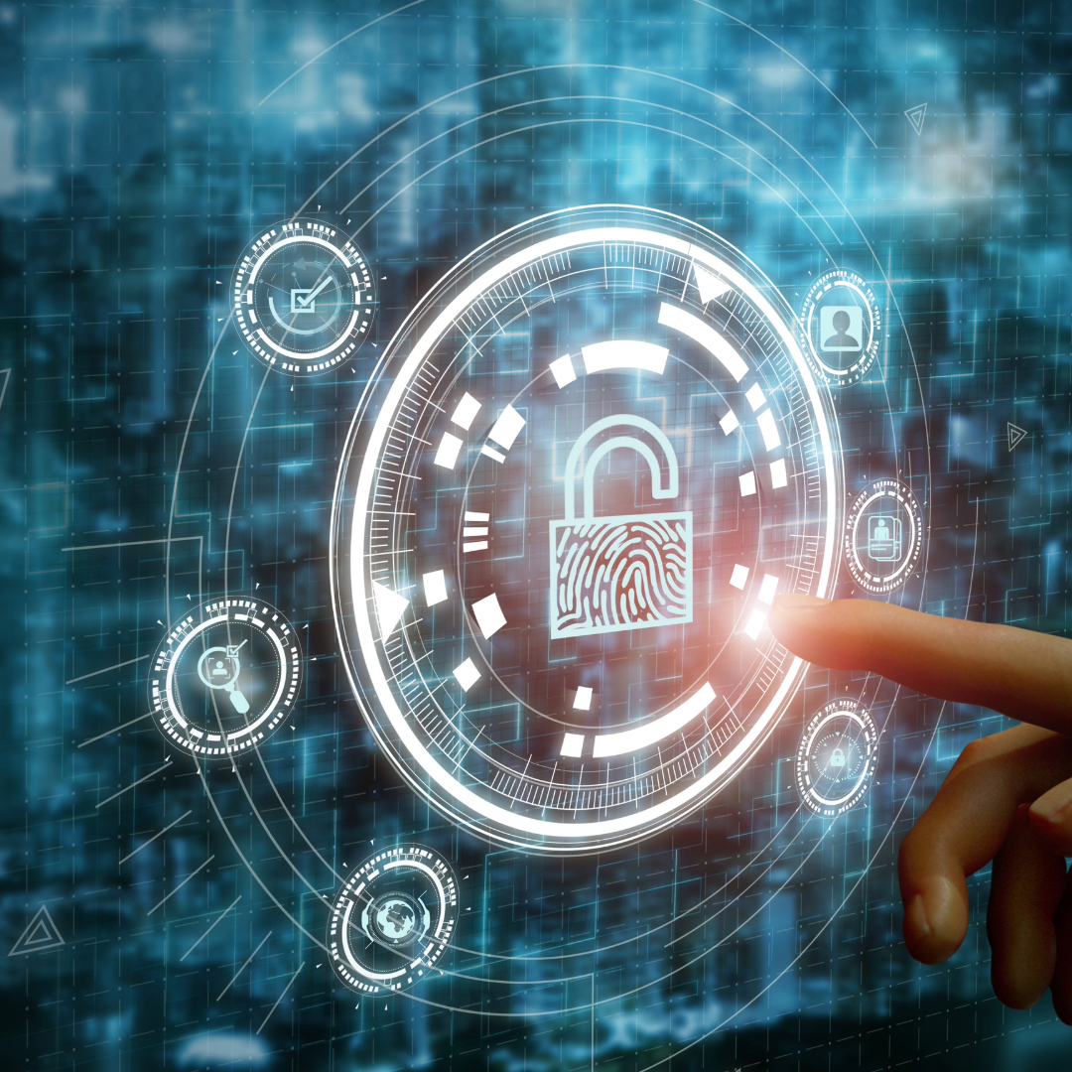
Building Trust & Resilience: Leveraging Technology
AI and Machine Learning
Detect suspicious patterns, flag anomalies, and identify potential fraudulent activities in real time. These technologies can analyze large volumes of data to uncover patterns that human analysts might miss
Biometric Authentication
Implement biometric technologies (like facial recognition, fingerprint scans, and voice recognition) to ensure that only authorized users can access sensitive data or complete high-value transactions
Encryption and Tokenization
Protect data during transmission and storage with encryption, ensuring it remains inaccessible to unauthorized users. Tokenization replaces sensitive information with non-sensitive equivalents, reducing the risk of data exposure.
Behavioral Analytics
Monitor user behavior to detect deviations from normal activity. This includes tracking login times, IP addresses, typing patterns, and device usage to identify potentially fraudulent users.

Slide 13
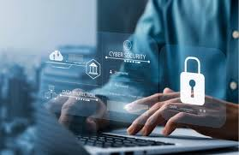
Enhancing Cybersecurity Infrastructure
Multi-Factor Authentication (MFA)
1
multiple forms of verification (like passwords, SMS codes, or biometric checks) to reduce the risk of account takeovers..
Audits and Penetration Testing
2
Conduct periodic security assessments to identify vulnerabilities and fix them.
Zero Trust Architecture:
3
“never trust, always verify” approach. This ensures that users, devices, and applications are constantly verified,
Secure APIs:
4
Most digital services rely on APIs, securing them against attacks like injection, data exposure, or Denial of Service (DoS) is crucial..

Slide 14

Regulatory Compliance and Governance
01
02
03
04
Data Privacy Laws
Financial Regulations
KYC and AML procedures
National Regulators
Comply with regulations like the Data Protection These laws enforce stringent data protection measures that can reduce fraud..
Adhere to standards like the Payment Card Industry Data Security Standard (PCI DSS) to protect online payment systems.
Implement robust KYC and AML procedures to verify the identities of users and monitor for illicit activities..
Central Bank, National Cyber Authority, National Communication authority regulations should be enforced.

Slide 15
Intensify Education and Awareness
1
CONSUMER AWARENESS
Educate users on common fraud tactics (like phishing, social engineering, and fake websites) to help them recognize and avoid scams. National Cyber Awareness Month inadequate
2
EMPLOYEE TRAINING
Train employees on cybersecurity best practices, phishing recognition, and secure handling of sensitive data to reduce internal vulnerabilities.
3
PUBLIC- PRIVATE PARTNERSHIPS
Foster collaboration between governments, private companies, and law enforcement agencies to share intelligence on emerging threats..

Slide 16
Final Thoughts
Ghana Card Utilization
Aggressive Collaboration
A unified Identification System.
Ghana Card more than a plastic.
Address Verification System
Banks,
Telecom,
FinTechs
State Institutions.
Security Agencies
Regulators
02
01
04
03
Data Driven
Human Vulnerability
Value Data
Protect Data
Data based Decision.
Technology Investment
Citizens and employee Education
Ethical Staff
Notes:
https://pixabay.com/es/photos/negocio-hombre-empresario-1042706/
https://pixabay.com/es/photos/modelo-empresario-corporativo-2911332/
https://pixabay.com/es/photos/gente-mujer-llamada-tienda-caf%c3%a9-2588594/
https://pixabay.com/es/photos/hombre-de-negocios-hombre-retrato-805769/
https://pixabay.com/es/photos/mujer-trabajo-oficina-pizarron-4702060/
https://pixabay.com/es/photos/empresario-hombre-corredor-de-bolsa-481113/
https://www.pexels.com/es-es/foto/hombre-de-chaqueta-de-traje-negro-con-ordenador-portatil-plateado-3777564/

Slide 17

THANK YOU

